Slide 1
Image Noise Reduction

Slide 2
Concepts
Noise in digital images can result from image acquisition (digitization) and transmission
Imaging sensors can be affected by ambient conditions
Interference can be added to an image during transmission
Common types of image noise include:
Salt and pepper noise: contains random occurrences of black & white pixels
Impulse noise: contains random occurrences of white pixels
Gaussian noise: variations in intensity drawn from a Gaussian normal distribution

Slide 3
Noise Model
We can consider a noisy image to be modelled as follows:
where f(x, y) is the original image pixel, η(x, y) is the noise term and g(x, y) is the resulting noisy pixel
If we can estimate the noise model we can figure out how to restore the image

Slide 4
Filtering to Remove Noise
We can use spatial filters of different kinds to remove different kinds of noise
The arithmetic mean filter is a very simple one and is calculated as follows:
¹/₉ | ¹/₉ | ¹/₉
¹/₉ | ¹/₉ | ¹/₉
¹/₉ | ¹/₉ | ¹/₉
This is implemented as a simple arithmetic filter and blurs the image

Slide 5
Median Filter
Median Filter:
Excellent at noise removal, without the smoothing effects that can occur with other smoothing filters
Particularly good when salt and pepper noise is present

Slide 6
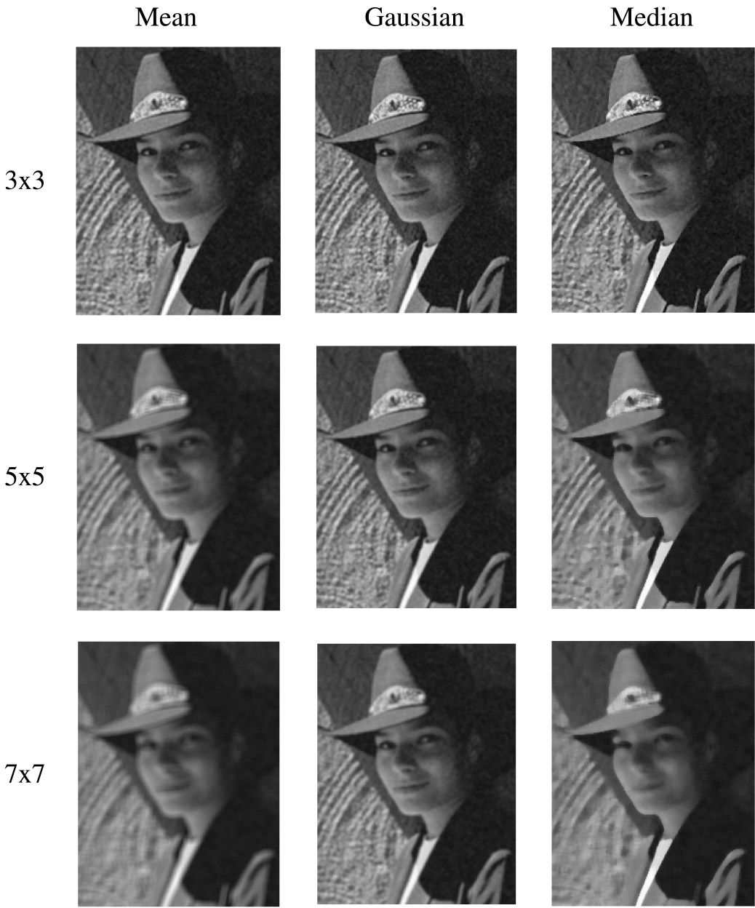
Comparison: Gaussian noise

Slide 7
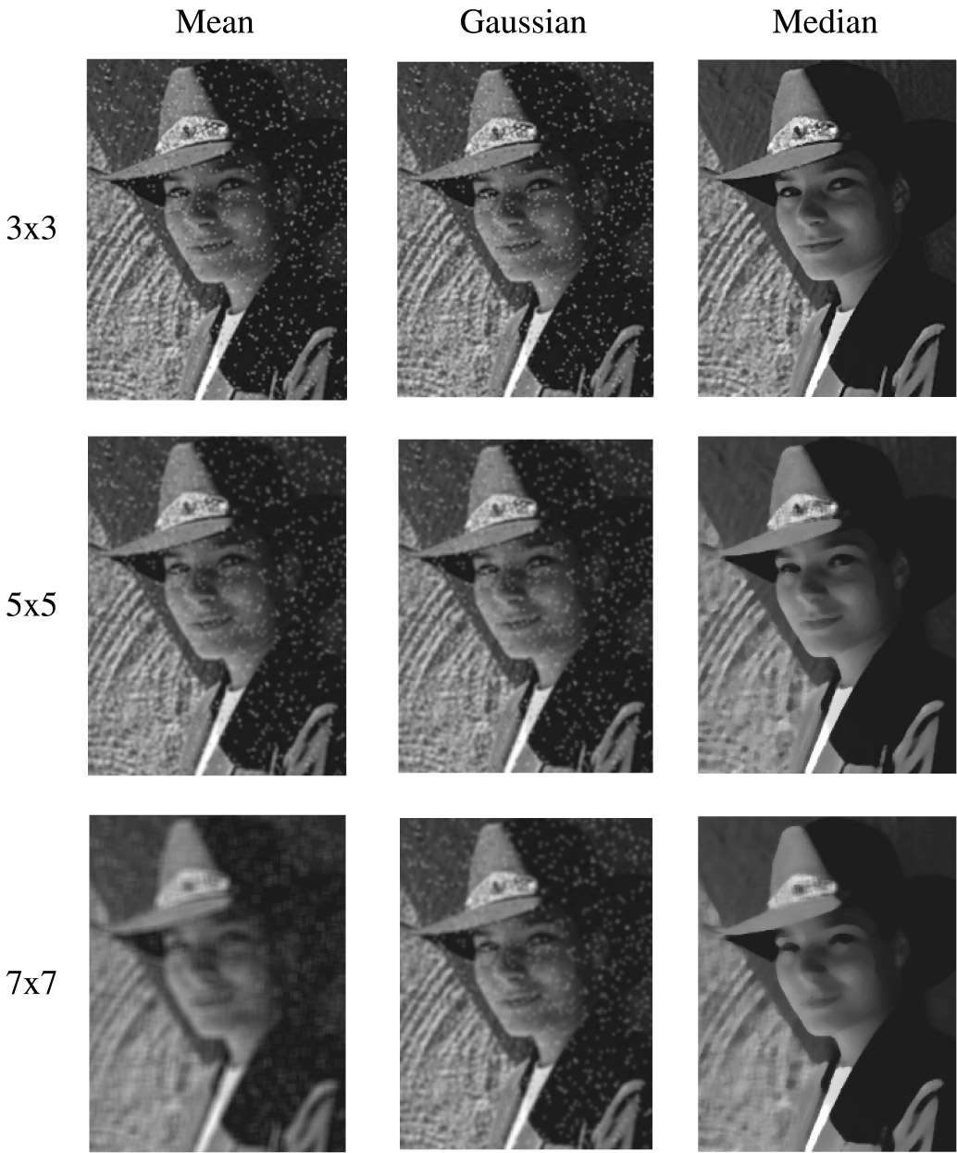
Comparison: Salt & Pepper Noise

Slide 8
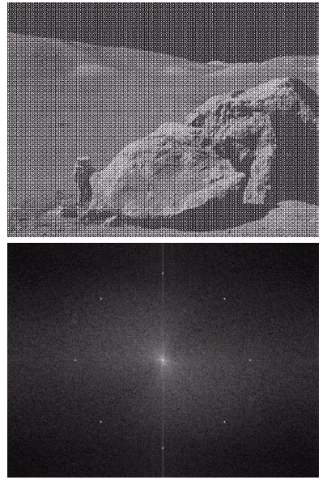
Periodic Noise
Typically arises due to electrical or electromagnetic interference
Gives rise to regular noise patterns in an image
Frequency domain techniques in the Fourier domain are most effective at removing periodic noise

Slide 9
Band Reject Filters
Removing periodic noise from an image involves removing a particular range of frequencies from that image
Band reject filters can be used for this purpose
An ideal band reject filter is given as follows:

Slide 10
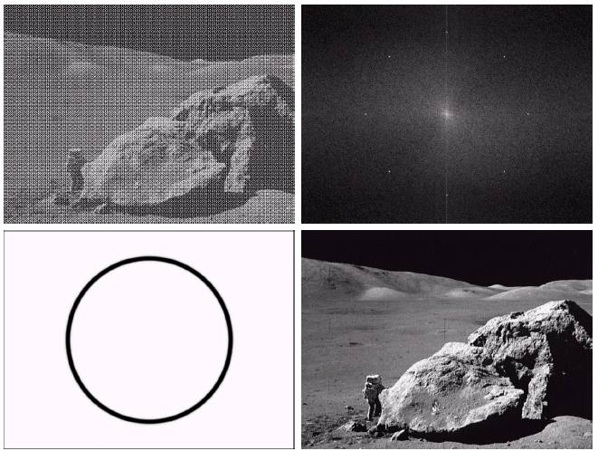
Band Reject Filter Example
Image corrupted by sinusoidal noise
Fourier spectrum of corrupted image
Butterworth band reject filter
Filtered image

